Slide 1
Battle of the Neighborhoods Capstone Project
BBQ Chain Expansion

Slide 2
Introduction
A BBQ restaurant chain wants to expand internationally, the client and fellow stake holders are interested in the city of Toronto, Canada. The Client was born and raised in the city, and after moving the southern states of America, began to open “Build your own plate” style BBQ restaurants (think Chipotle). The clients are interested in opening multiple location across the city of Toronto and have request the task we provide other established restaurant information.
The main objectives of this assignment is to identify the number of restaurants in a given location of Toronto to determine the amount of competition in the area, and to see if there is an established running BBQ restaurant in the area.

Slide 3
City Information
Toronto, Canada is the capital of the province of Ontario. The city consists of 6.19 million people (worldpopulation.com). The population of Toronto has a median income of $83,020. (statcan.gc.ca)

Slide 4
Data Sources
The data for the restaurants will be provided by https://developer.foursquare.com/ for the latest and update restaurant information. For the zip code and neighborhood locations we will be using a Wikipedia table https://en.wikipedia.org/wiki/List_of_postal_codes_of_Canada:_M. For the location of the neighborhoods and postal codes provided via Wikipedia, we will be using https://cocl.us/Geospatial_data for the Latitude and Longitude values.

Slide 5
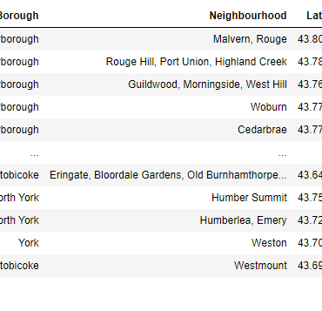
Data Cleaning
The data scraped from multiple sources will be place into a combined Pandas data frame table. Any missing “neighborhood” values will be replaced with “borough” information. If there is a cell with no “borough” information that cell will be ignored. The data will be grouped by “Postal Codes” and ‘Borough”. We will also be eliminating multiple entries. When working with Foursquare data, we will be mainly focusing on “Restaurants”, even though we will briefly discuss other venues in the area.
After the data cleaning we are left with 100 rows of data by 5 columns. Those columns listed in order: Postal Code, Borough, Neighborhood, Latitude, and Longitude.

Slide 6
Data Analysis
Again, our main object was to assess the competition in the area, along with analyzing the amount of other venues in the area, including other restaurants. After running our analysis we are left with 50 different restaurants in each City (This is due to Foursquare rate limit).

Slide 7
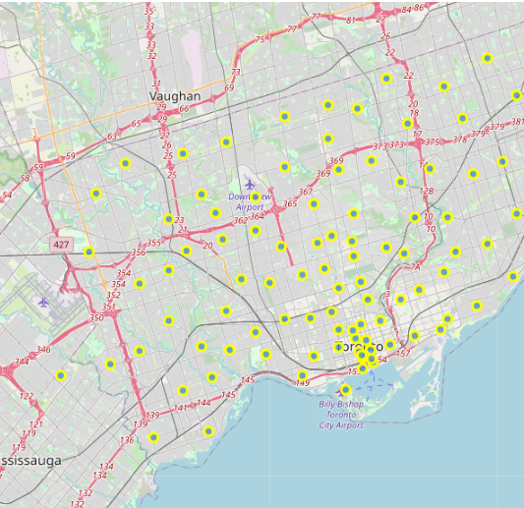
Data Visualization
The first thing analyzed was a map of Toronto, and the neighborhoods within. This is done to get a sense of the entire location the client is interested in along with the different areas. We generated this map with the neighborhoods superimposed on top with yellow circles.

Slide 8
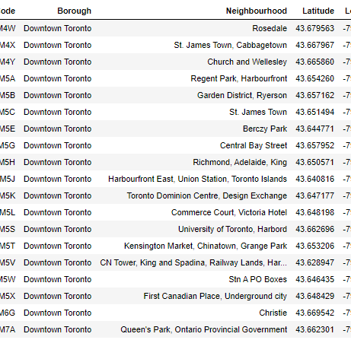
The client has expressed interested in a denser part of the city, so our first Borough we looked closely at Downtown Toronto. Downtown consist of several different neighborhoods, some of which share postal codes as seen.

Slide 9
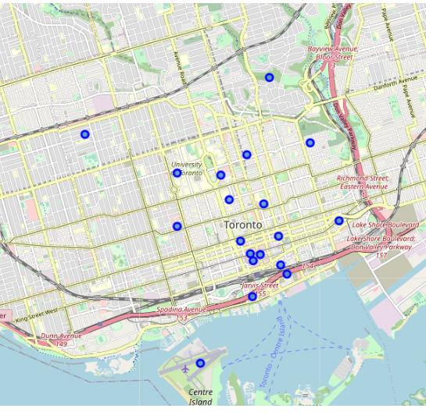
Neighborhood map of Downtown Toronto
Here we can see a map with the neighborhoods superimposed on top of Downtown Toronto, blue circles indicate their neighborhood center.

Slide 10
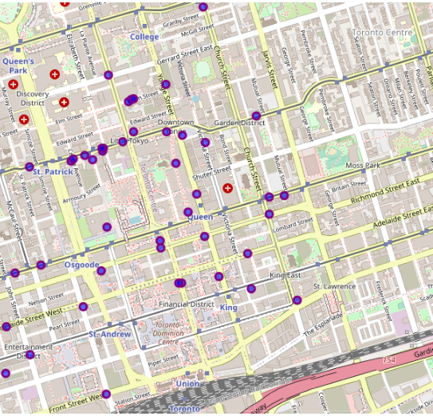
Restaurant map of DownTown Toronto
Next, we analyzed the restaurants in this area, allowing us to identify 50 different operating venues.(Reminder, Foursquare only allowed us to call 50, with a limit set to 500.)
We visualized and superimposed their location on a map of Downtown Toronto.
From looking at the map above, we notice a cluster of different restaurants on the same street, Dundas Street West, within a few blocks between Younge Street, and Spadina Avenues, which happens to be the beginning of China Town.

Slide 11
Scarborough
Next, we take a close look at Scarborough, which is located West of Downtown Toronto. Scarborough consist of less neighborhoods and postal codes.

Slide 12
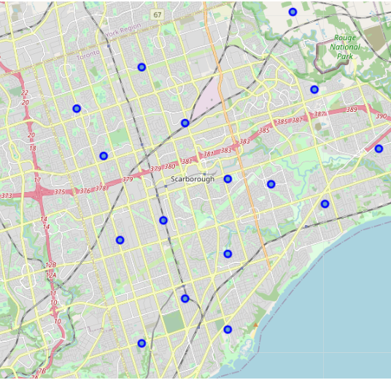
Neighborhood map of Scarborough
Just like before, we took a closer look at Scarborough with its neighborhoods superimposed on top.

Slide 13
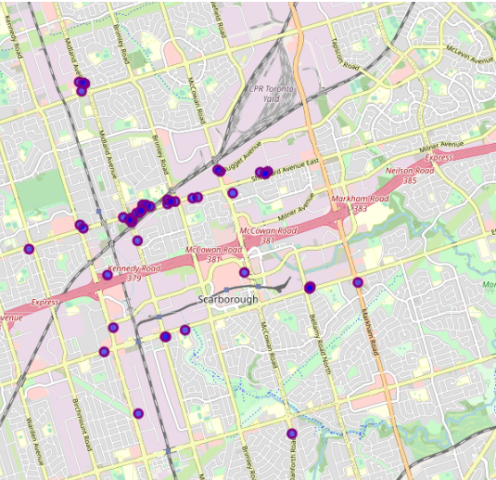
Restaurant map of Scarborough
Next, like before, we will analyze the restaurants in Scarborough.
Again, we superimposed to location of the establishments on top of a map of Scarborough to better visualize the area.
The majority of establishments are located again on one street, Sheppard Avenue East, and the biggest chunk of those are clustered between Brimley Road and Midland Avenue.

Slide 14
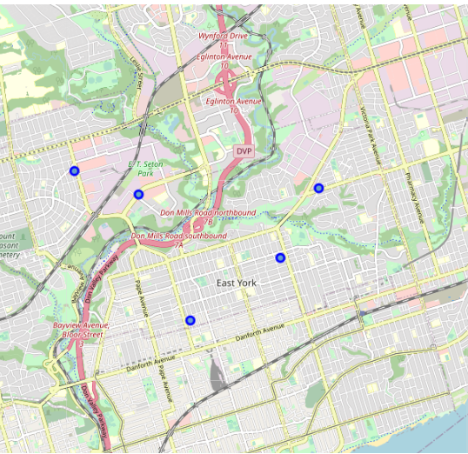
Neighborhood map of East York
Finally, we look at the clients last request, East York. East York has few neighborhoods as we can see from the map below. East York is located between Downtown Toronto and Scarborough.
We can see from the map that there are less neighborhoods in a much smaller area.

Slide 15
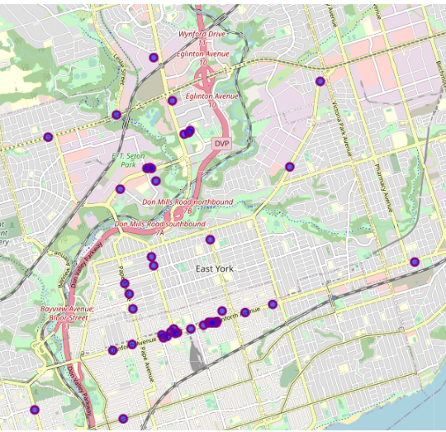
Restaurant Map of East York
Again, we analyzed the restaurants in the area.
And we superimposed the location of the establishments on top of a map of East York.
Again, most establishments are location on a single street, Danforth Avenue. With the majority located between the blocks of Jones Avenue and Coxwell Avenue.

Slide 16
Competition
After assessing the data retrieved from Foursquare we can safely estimate that restaurant competition is very high, with a diverse choice of establishments and a growing and demanding business population.

Slide 17
Restaurant Uniqueness
After assessing the data retrieved from Foursquare we can safely estimate that the client’s restaurant chain will be unique to the area, offering the residents, tourist, and business travels a different option in the area.

Slide 18
Recommended starting location
After assessing three different areas of the city, and assessing the type of restaurants in the area, we recommend opening a location in downtown Toronto. Doing so will offer a wide variety of clients while offering an experience that is totally unique to the area.

Slide 19
Conclusion
The client requested information regarding there BBQ chain, the information requested was about the local restaurants located in the greater Toronto area, a prospect city for expiation of the chain. We gathered this information using the latest Foursquare data. By being able to visualize and obtain restaurants in three selected areas of the city, Downtown Toronto, Scarborough, and East York, we came to the conclusion that the restaurant experience would be unique, but the competition in the areas are extremely high. Toronto has a growing, diverse, and business population, all of which could provide opportunity to grow the chain with this unique dinning experience for the area.

